Slide 1


Time Series Analysis for Stock Price Prediction

Slide 2
Aysha Shiddika 180104054
Hasan Bin Jamal 180104070
Fatima Juairiah 180104071
Mostafa Mahatabe 180104074

Slide 3


Table of Contents
01
Introduction
02
Related Work
03
Dataset
04
Back Ground Study
05
Result Analysis
06
Conclusion

Slide 4
Introduction
A stock data set contains numerous precise terms that are difficult for an individual to comprehend when considering stock market expenditures.
A time series is an accumulation of analyses of data items over a specific time period.
Stock Market Prediction is an example of time-series forecasting that promptly examines previous data and estimates future data values.

Slide 5
Related Works
SL | Paper Title | Author | Datasets | Models | Accuracy
01 | Prediction of stock price based on LSTM. | D. Wei | 300 indexes of representative relevance for China’s stock market for the dataset, which included six parameters such as trading date, opening price, closing price, lowest price, maximum price, and daily volume of the stock | LSTM | 95.70% accuracy on the training dataset and 80% on the test dataset.
02 | Applying long short term memory neural networks for predicting stock closing price | T. Gao, Y. Chai, and Y. Liu | trading data from Yahoo Finance | LSTM | LSTM model performs better result for predictive experiments.

Slide 6
Related Works(Cont..)
Serial No | Paper Title | Author | Datasets | Models | Accuracy
03 | Stock price prediction using lstm and svr. | G. Bathla | The NYSE, NSE, NASDAQ, Dow Jones Industrial Average, and S & P 500 stock indexes | Linear Regression, Support Vector Machines, LSTM, CNN, RBM, ANN, ARIMA (Auto Regressive Integrated Moving Average), and standard machine learning approaches' | 92%
04 | Stock market prediction using LSTM recurrent neural network. | A. Moghar and M. Hamiche | GOOGL and NKE assets. | LSTM , RNN | gives better accuracy.

Slide 7
Data Set
The dataset is collected from Kaggle, which is a machine learning community platform.
We will use the 2022 Microsoft Corporation Stock dataset which is consisting of 9166 data.
The dataset contains 7 features:
Date.
High.
Low.
Opening price.
Closing price.
Adj close
Volume.

Slide 8

Applied Models
ARIMA
LSTM
BI-LSTM
HMM
TRANSFORMER

Slide 9
Background
Autoregressive Integrated Moving Average (ARIMA)
It miles a category of the version that captures a collection of various trendy temporal systems in time collection information .
The parameters of the ARIMA version are described as p,d,q.
ARIMA is super healthy to seize ancient trends, seasonality, randomness, and other non-static conduct that people miss.

Slide 10
Background (cont..)
Long Short-term Memory (LSTM)
A cell state, three gates, and an LSTM module allow them to selectively learn, unlearn, or retain information from each of the units.
It has an output, a forget gate, and three inputs.
The vanishing gradient issue can be resolved via long short-term memory.
Bidirectional Long-short Term Memory (Bidirectional LSTM)
Neural network may keep the sequence in both directions: backward (future to past) or forward (past to future).
Gradients fade and explode.

Slide 11
Background (Cont..)
Hidden Markov Model (HMM)
Extracting the hidden parameters from the visible parameters in a system considered a Markov process with unknown parameters.
Transition probability, Emission probability, and initial probability.
Transformer Model
Transformer model is so strong for time series analysis in the case of both stationary or non stationary data.
Applying an evolving set of mathematical techniques, known as attention or self-attention.
Transfiguration translates text and speech near real-time, opening meetings and classes to diverse and hearing impaired participants.

Slide 12
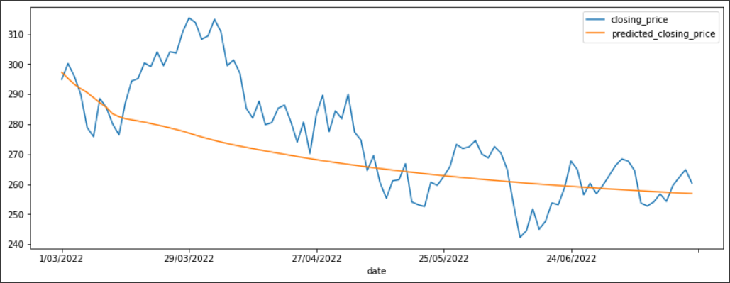
Result Analysis
BiLSTM Model
Our input is bidirectional and flows in both directions, setting a BiLSTM apart from a conventional LSTM.
Giving better optimization and prediction result.

Slide 13
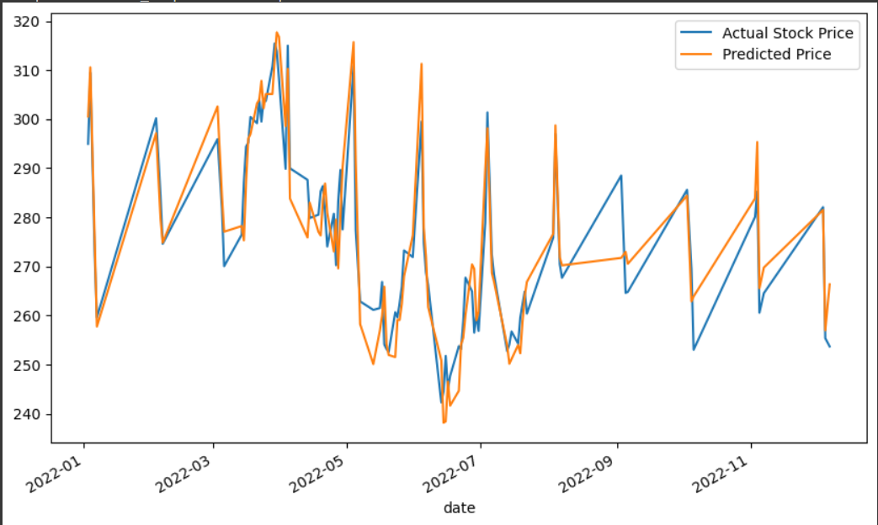
Result Analysis
ARIMA Model
It has the capability to capture sudden ups and downs in stock price .

Slide 14
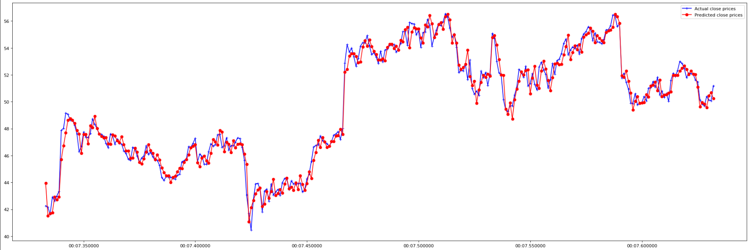
Result Analysis
HMM
Here, the 10 hidden components (or states) of our data were quickly recognized by the Hidden Markov model. The test data for the preceding 50 days will be used to test all potential outcomes for each of the days for which we will predict closing prices.
In the HMM , the task is to extract the hidden parameters from the visible parameters in a system considered a Markov process with unknown parameters.
Both long-term and short-term investors, this model will be very helpful.

Slide 15
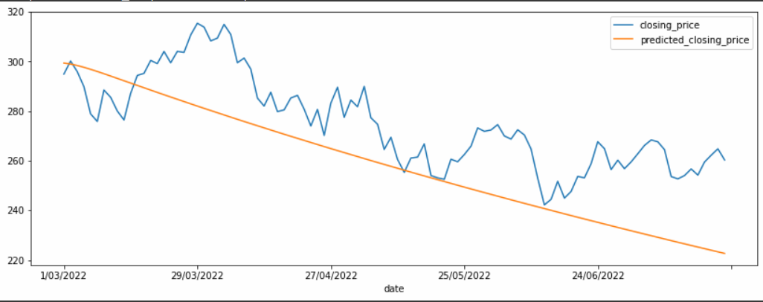
Result Analysis
LSTM Model
LSTM could not perform well because our dataset is stationary means no trends or pattern with respect to time.
Giving better when there is huge amount of data.

Slide 16
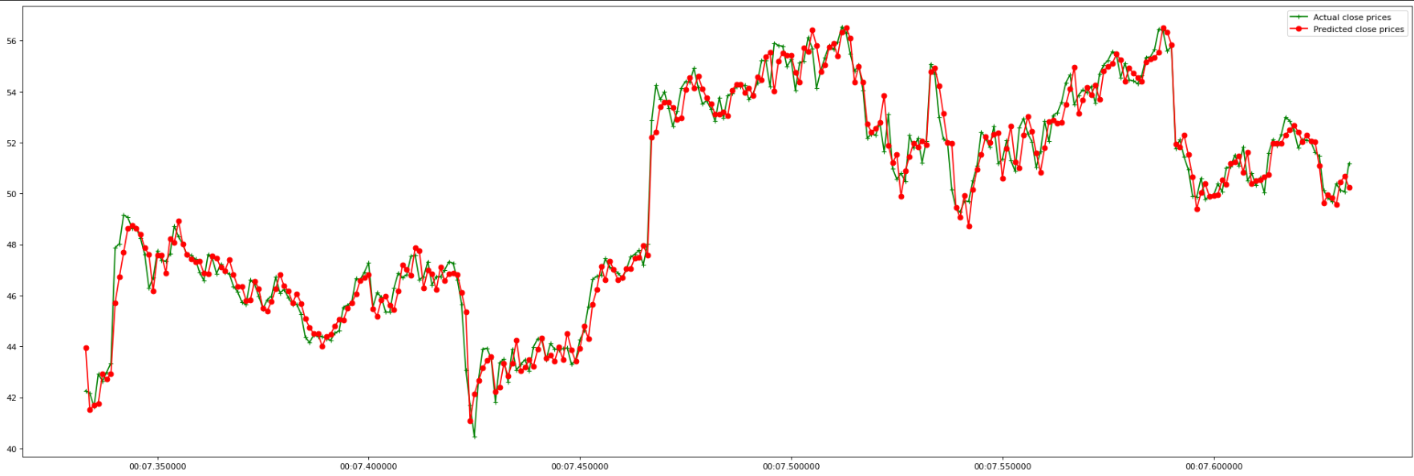
Result Analysis
Transformer Model
In our transformer model we used 60 attention head and Embedding size for attention was 46.
Number of transformer block was 5,Which is well fitted for our ten thousand data .
Adam optimizer and 0.14% dropout were used.

Slide 17
Result Analysis
Model | MAE | MSE | RMSE
Transformer | 0.099 | 0.023 | 0.153
HMM | 0.486 | 0.041 | 0.202
ARIMA | 5.467 | 44.539 | 6.674
BiLSTM | 11.256 | 217.860 | 14.760
LSTM | 18.541 | 461.942 | 21.493

Slide 18
Result Analysis(cont..)
The Attention module of the Transformer performs its calculations repeatedly and concurrently.
In comparing LSTM and Bidirectional LSTM, Bidirectional LSTM performs better than LSTM.
Transformer > HMM > ARIMA > BiLSTM > LSTM

Slide 19
Conclusion
Despite volatility, stock prices are more than just randomly generated numbers.
By treating stock market data as a time series, one can use past stock prices to predict stock prices for the next month.
It reveals the future behavior of the market, always helping investors understand when and what types of stocks can be purchased to grow their investment.

Slide 20
Thank you

